Slide 1
W4111 – Introduction to Databases Section 002, Spring 2024 Lecture 7: ER, Relational, SQL (VI)
© Donald F. Ferguson, 2024

Slide 2
W4111 – Introduction to Databases Section 002, Spring 2024 Lecture 7: ER, Relational, SQL (VI)
We will start in a couple of minutes.
© Donald F. Ferguson, 2024

Slide 3

Contents
3 | COMS W4111_002_2024_1: Lecture 7: ER, Relational, SQL (VI) © Donald F. Ferguson, 2024

Slide 4
Contents
WITH clause and Common Table Expressions revisited.

Slide 5
SQL
5 | COMS W4111_002_2024_1: Lecture 7: ER, Relational, SQL (VI) © Donald F. Ferguson, 2024

Slide 6

WITH Clause
Common Table Expressions
6 | COMS W4111_002_2024_1: Lecture 7: ER, Relational, SQL (VI) © Donald F. Ferguson, 2024

Slide 7
With Clause
The with clause provides a way of defining a temporary relation whose definition is available only to the query in which the with clause occurs.
Find all departments with the maximum budget with max_budget (value) as (select max(budget) from department) select department.name from department, max_budget where department.budget = max_budget.value;

Slide 8
Complex Queries using With Clause
Find all departments where the total salary is greater than the average of the total salary at all departments
with dept _total (dept_name, value) as
(select dept_name, sum(salary)
from instructor
group by dept_name),
dept_total_avg(value) as
(select avg(value)
from dept_total)
select dept_name
from dept_total, dept_total_avg
where dept_total.value > dept_total_avg.value;

Slide 9
Common Table Expressions
CTE: (https://www.essentialsql.com/introduction-common-table-expressions-ctes/)
“The Common Table Expressions or CTE’s for short are used within SQL (...) to simplify complex joins and subqueries, ...”
“A CTE (Common Table Expression) defines a temporary result set which you can then use in a SELECT statement. It becomes a convenient way to manage complicated queries.”
There are two types of CTEs:
Non-recursive.
Recursive (note, recursive SQL weirds me out).
The benefits are clarity and improved quality through incremental development.
Basic syntax by example.
There may be several CTEs.
A CTE can reference other CTEs.

Slide 10
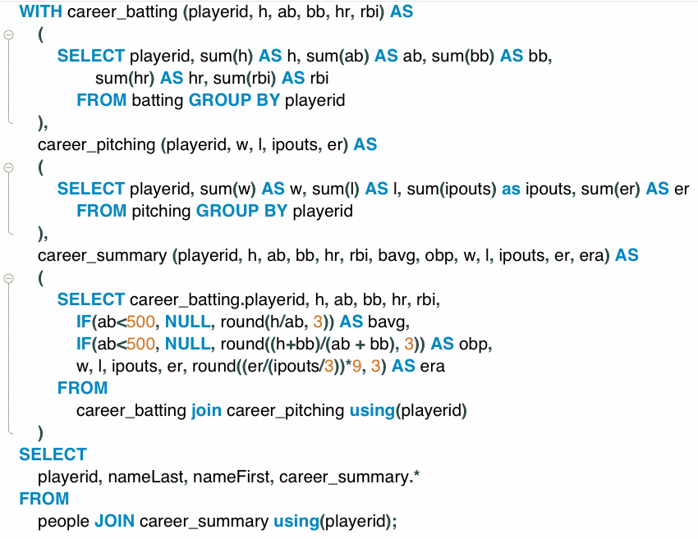
Common Table Expressions – Example
Producing a career summary requires several tasks:
Computing batting totals
Computing pitching totals
Applying formulas to produce derived averages and metrics.
Joining (1), (2) and (3) into a career summary.
Joining with people to bring in personal information.
Producing the table is possible with a single SELECT statement, but ... ...
Developing incrementally one simpler query at a time is easier.
The resulting query is easier to understand and maintain.

Slide 11
Common Table Expressions – Example
Producing a career summary requires several tasks:
Computing batting totals
Computing pitching totals
Applying formulas to produce derived averages and metrics.
Joining (1), (2) and (3) into a career summary.
Joining with people to bring in personal information.
Producing the table is possible with a single SELECT statement, but ... ...
Developing incrementally one simpler query at a time is easier.
The resulting query is easier to understand and maintain.
I find it difficult to impossible to write complex queries without using CTEs.
I think about incremental steps to produce the result.
Write and test the CTE by adding one step at a time.
Please, please, please:
Use CTEs.
Use DataGrip

Slide 12
Recursive Queries
12 | COMS W4111_002_2024_1: Lecture 7: ER, Relational, SQL (VI) © Donald F. Ferguson, 2024

Slide 13
Recursion in SQL
SQL:1999 permits recursive view definition
Example: find which courses are a prerequisite, whether directly or indirectly, for a specific course with recursive rec_prereq(course_id, prereq_id) as ( select course_id, prereq_id from prereq union select rec_prereq.course_id, prereq.prereq_id, from rec_rereq, prereq where rec_prereq.prereq_id = prereq.course_id ) select ∗ from rec_prereq;
This example view, rec_prereq, is called the transitive closure of the prereq relation

Slide 14
The Power of Recursion
Recursive views make it possible to write queries, such as transitive closure queries, that cannot be written without recursion or iteration.
Intuition: Without recursion, a non-recursive non-iterative program can perform only a fixed number of joins of prereq with itself
This can give only a fixed number of levels of managers
Given a fixed non-recursive query, we can construct a database with a greater number of levels of prerequisites on which the query will not work
Alternative: write a procedure to iterate as many times as required
See procedure findAllPrereqs in book
Since SQL is not Turing complete, there are many computations it cannot perform.
Recursion enables some scenarios, but recursion in general is hard to understand.
Switch to notebook

Slide 15
Advanced Aggregation
Window Functions
15 | COMS W4111_002_2024_1: Lecture 7: ER, Relational, SQL (VI) © Donald F. Ferguson, 2024

Slide 16
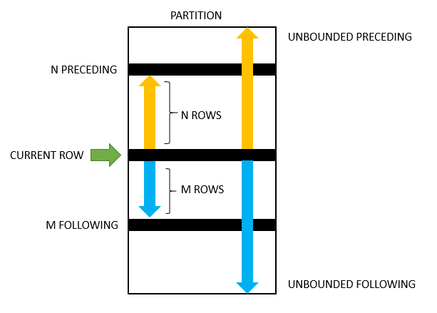
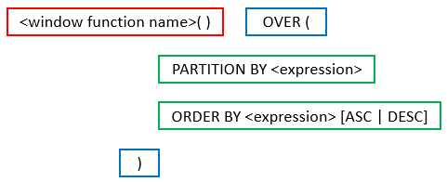
Advanced Aggregates and Window Functions
The aggregation functions in SQL are powerful.
There are some scenarios that are very difficult. SQL and databases add support for more advanced capabilities:
Ranking
Windows
Pivot, Slice and Dice, but we will cover these with a different technology (OLAP) later in the semester.
This is powerful, a little complex and requires trial and error.

Slide 17
Switch to Notebook
Note – This takes a lot of practice and “help.”
To verify, in some cases you can
Use a subset of of the data, e.g. filter by country.
Compute the aggregate using normal aggregation.
Copy into Excel/Sheets, write some formulas and verify.
This is quite powerful. There will be a couple of take home HW/exam questions, but this takes tinkering.

Slide 18
Security
18 | COMS W4111_002_2024_1: Lecture 7: ER, Relational, SQL (VI) © Donald F. Ferguson, 2024

Slide 19
Security Concepts (Terms from Wikipedia)
Definitions:
“A (digital) identity is information on an entity used by computer systems to represent an external agent. That agent may be a person, organization, application, or device.”
“Authentication is the act of proving an assertion, such as the identity of a computer system user. In contrast with identification, the act of indicating a person or thing's identity, authentication is the process of verifying that identity.”
“Authorization is the function of specifying access rights/privileges to resources, ... More formally, "to authorize" is to define an access policy. ... During operation, the system uses the access control rules to decide whether access requests from (authenticated) consumers shall be approved (granted) or disapproved.
“Within an organization, roles are created for various job functions. The permissions to perform certain operations are assigned to specific roles. Members or staff (or other system users) are assigned particular roles, and through those role assignments acquire the permissions needed to perform particular system functions.”
“In computing, privilege is defined as the delegation of authority to perform security-relevant functions on a computer system. A privilege allows a user to perform an action with security consequences. Examples of various privileges include the ability to create a new user, install software, or change kernel functions.”
SQL and relational database management systems implementing security by:
Creating identities and authentication policies.
Creating roles and assigning identities to roles.
Granting and revoking privileges to/from roles and identities.

Slide 20
Authorization
We may assign a user several forms of authorizations on parts of the database.
Read - allows reading, but not modification of data.
Insert - allows insertion of new data, but not modification of existing data.
Update - allows modification, but not deletion of data.
Delete - allows deletion of data.
Each of these types of authorizations is called a privilege. We may authorize the user all, none, or a combination of these types of privileges on specified parts of a database, such as a relation or a view.

Slide 21
Authorization (Cont.)
Forms of authorization to modify the database schema
Index - allows creation and deletion of indices.
Resources - allows creation of new relations.
Alteration - allows addition or deletion of attributes in a relation.
Drop - allows deletion of relations.

Slide 22
Authorization Specification in SQL
The grant statement is used to confer authorization
grant <privilege list> on <relation or view > to <user list>
<user list> is:
a user-id
public, which allows all valid users the privilege granted
A role (more on this later)
Example:
grant select on department to Amit, Satoshi
Granting a privilege on a view does not imply granting any privileges on the underlying relations.
The grantor of the privilege must already hold the privilege on the specified item (or be the database administrator).

Slide 23
Privileges in SQL
select: allows read access to relation, or the ability to query using the view
Example: grant users U₁, U₂, and U₃ select authorization on the instructor relation:
grant select on instructor to U₁, U₂, U₃
insert: the ability to insert tuples
update: the ability to update using the SQL update statement
delete: the ability to delete tuples.
all privileges: used as a short form for all the allowable privileges

Slide 24
Revoking Authorization in SQL
The revoke statement is used to revoke authorization.
revoke <privilege list> on <relation or view> from <user list>
Example:
revoke select on student from U₁, U₂, U₃
<privilege-list> may be all to revoke all privileges the revokee may hold.
If <revokee-list> includes public, all users lose the privilege except those granted it explicitly.
If the same privilege was granted twice to the same user by different grantees, the user may retain the privilege after the revocation.
All privileges that depend on the privilege being revoked are also revoked.

Slide 25
Roles
A role is a way to distinguish among various users as far as what these users can access/update in the database.
To create a role we use:
create a role <name>
Example:
create role instructor
Once a role is created we can assign “users” to the role using:
grant <role> to <users>

Slide 26
Roles Example
create role instructor;
grant instructor to Amit;
Privileges can be granted to roles:
grant select on takes to instructor;
Roles can be granted to users, as well as to other roles
create role teaching_assistant
grant teaching_assistant to instructor;
Instructor inherits all privileges of teaching_assistant
Chain of roles
create role dean;
grant instructor to dean;
grant dean to Satoshi;

Slide 27
Authorization on Views
create view geo_instructor as (select * from instructor where dept_name = 'Geology');
grant select on geo_instructor to geo_staff
Suppose that a geo_staff member issues
select * from geo_instructor;
What if
geo_staff does not have permissions on instructor?
Creator of view did not have some permissions on instructor?

Slide 28
Other Authorization Features
references privilege to create foreign key
grant reference (dept_name) on department to Mariano;
Why is this required?
transfer of privileges
grant select on department to Amit with grant option;
revoke select on department from Amit, Satoshi cascade;
revoke select on department from Amit, Satoshi restrict;
And more!
Note:
Like in many other cases, SQL DBMS have product specific variations.
Switch to notebook.

Slide 29
Worked Example – Or Mock Prof. Ferguson While He Codes
29 | COMS W4111_002_2024_1: Lecture 7: ER, Relational, SQL (VI) © Donald F. Ferguson, 2024

Slide 30
Scenario
The data model is:
Students
Faculty
An abstract base type Person
We will
Draw the logical and a partial physical ER diagram.
Generate some test data using Mockaroo. We will load the data and create the initial schema.
Give you a bunch of data. --> Load → Tables → constraints
Implement a three-table solution, including indexes, views and constraints.
A function to compute UNIs.
Triggers to automatically assign UNIs.
Stored procedures to create student, faculty.
Create non-root users.
Revoke SQL operations to prevent people from making mistakes.
Snicker at Prof. Ferguson. I put this last, but it will like occur during all steps.

Slide 31
REST
31 | COMS W4111_002_2024_1: Lecture 7: ER, Relational, SQL (VI) © Donald F. Ferguson, 2024

Slide 32
Data Modeling Concepts and REST
Almost any data model has the same core concepts:
Types and instances:
Entity Type: A definition of a type of thing with properties and relationships.
Entity Instance: A specific instantiation of the Entity Type
Entity Set Instance: An Entity Type that:
Has properties and relationships like any entity, but ...
Has at least one special relationship – contains.
Operations, minimally CRUD, that manipulate entity types and instances:
Create
Retrieve
Update
Delete
Reference/Identify/... ...

Slide 33
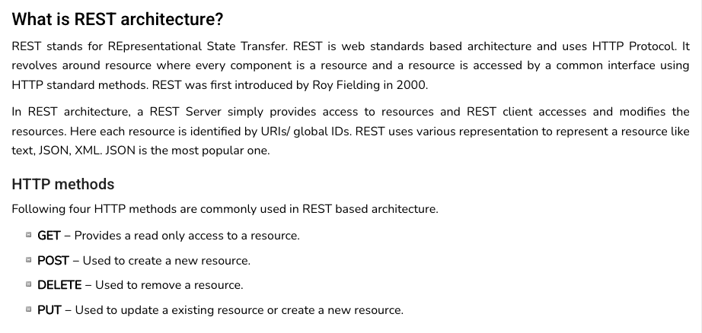
REST (https://www.tutorialspoint.com/restful/restful_introduction.htm)

Slide 34
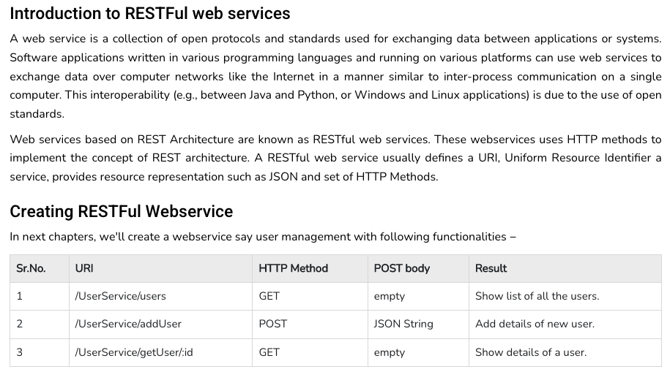
REST (https://www.tutorialspoint.com/restful/restful_introduction.htm)

Slide 35
REST and Resources

Slide 36
URLs

Slide 37
Simplistic, Conceptual Mapping (Examples)
REST Method | Resource Path | Relational Operation | DB Resource
DELETE | /people | DROP TABLE | people table
POST | /people | INSERT INTO PEOPLE (...) VALUES(...) | people table people row
GET | /people/21 | SHOW KEYS FROM people ...; SELECT * FROM people WHERE playerID= 21 | people row
GET | /people/21/batting | SELECT batting.* FROM people JOIN batting USING(playerID) WHERE playerID=21
GET | /people/21/batting/2004_1 | SELECT batting.* FROM people JOIN batting USING(playerID) WHERE playerID=21 AND yearID=2004 AND stint=1

Slide 38
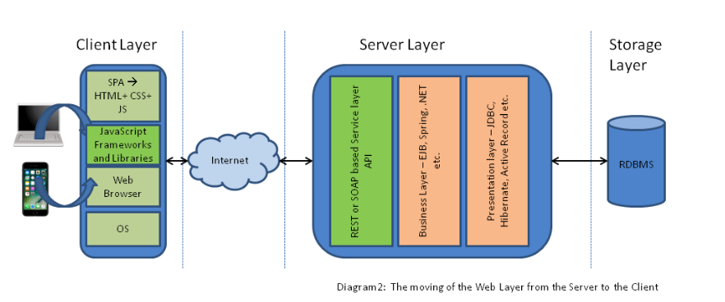
Application Architecture

Slide 39
Walkthrough Code
/Users/donaldferguson/Dropbox/000/000-A-Current-Examples/W4111-FastAPI-IMDB-Solution
/Users/donaldferguson/Dropbox/000/000-A-Current-Examples/current-dashboard

Slide 40
Big Data Business Intelligence
Decision Support (Preview to enable project)
40 | COMS W4111_002_2024_1: Lecture 7: ER, Relational, SQL (VI) © Donald F. Ferguson, 2024

Slide 41
Decision Support Systems
Decision-support systems are used to make business decisions, often based on data collected by on-line transaction-processing systems.
Examples of business decisions:
What items to stock?
What insurance premium to change?
To whom to send advertisements?
Examples of data used for making decisions
Retail sales transaction details
Customer profiles (income, age, gender, etc.)

Slide 42
Decision-Support Systems: Overview
Data analysis tasks are simplified by specialized tools and SQL extensions
Example tasks
For each product category and each region, what were the total sales in the last quarter and how do they compare with the same quarter last year
As above, for each product category and each customer category
Statistical analysis packages (e.g., : S++) can be interfaced with databases
Statistical analysis is a large field, but not covered here
Data mining seeks to discover knowledge automatically in the form of statistical rules and patterns from large databases.
A data warehouse archives information gathered from multiple sources, and stores it under a unified schema, at a single site.
Important for large businesses that generate data from multiple divisions, possibly at multiple sites
Data may also be purchased externally

Slide 43
Data Warehousing
Data sources often store only current data, not historical data
Corporate decision making requires a unified view of all organizational data, including historical data
A data warehouse is a repository (archive) of information gathered from multiple sources, stored under a unified schema, at a single site
Greatly simplifies querying, permits study of historical trends
Shifts decision support query load away from transaction processing systems

Slide 44
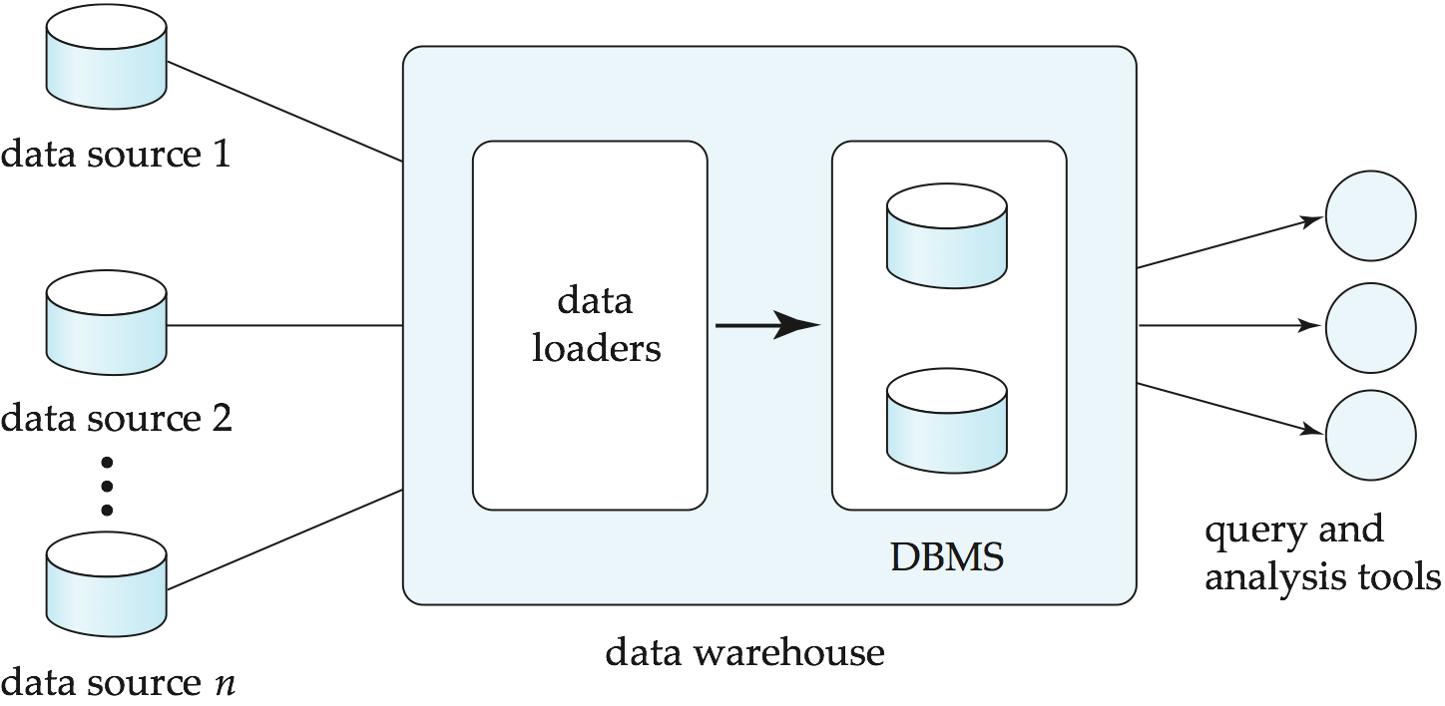
Data Warehousing

Slide 45
Data Warehouse vs Data Lake
https://www.grazitti.com/blog/data-lake-vs-data-warehouse-which-one-should-you-go-for/

Slide 46
Simplistic: Data Warehouse vs Data Lake
https://panoply.io/data-warehouse-guide/data-warehouse-vs-data-lake/

Slide 47
Design Issues
When and how to gather data
Source driven architecture: data sources transmit new information to warehouse, either continuously or periodically (e.g., at night)
Destination driven architecture: warehouse periodically requests new information from data sources
Keeping warehouse exactly synchronized with data sources (e.g., using two-phase commit) is too expensive
Usually OK to have slightly out-of-date data at warehouse
Data/updates are periodically downloaded form online transaction processing (OLTP) systems.
What schema to use
Schema integration

Slide 48
More Warehouse Design Issues
Data cleansing
E.g., correct mistakes in addresses (misspellings, zip code errors)
Merge address lists from different sources and purge duplicates
How to propagate updates
Warehouse schema may be a (materialized) view of schema from data sources
What data to summarize
Raw data may be too large to store on-line
Aggregate values (totals/subtotals) often suffice
Queries on raw data can often be transformed by query optimizer to use aggregate values

Slide 49
Sample Projects
49 | COMS W4111_002_2024_1: Lecture 7: ER, Relational, SQL (VI) © Donald F. Ferguson, 2024

Slide 50
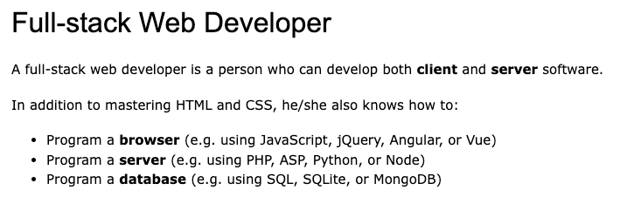
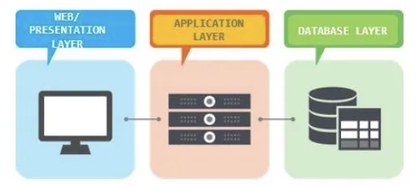
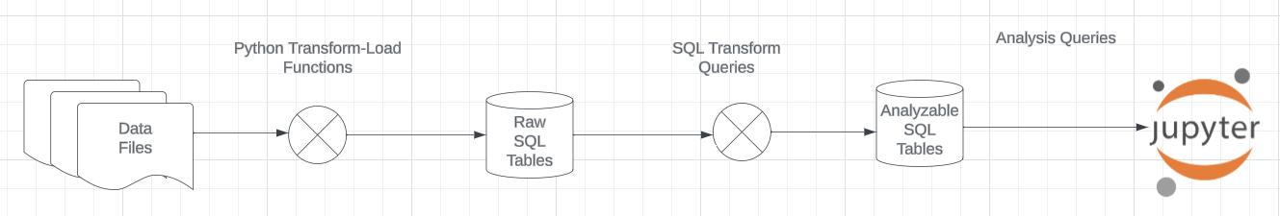
Projects
The programming track will implement a simple, full stack web application.
The non-programming track will implement a data engineering and visualization process in a Jupyter notebook via a simple data warehouse.

Slide 51
Game of Thrones
Bottom-Up Data Mapping:
“Nouns” usually map to Entity/Entity Set.
Nouns inside other nouns often map to:
Attribute
Relationship
Verbs often map to relationships.
Adjectives usually map to properties.
We will start with a subset of the information:
Game of Thrones:
Episodes
Characters
IMDB:
names_basics
title_basics
Entities Sets
Character
Season
Episode
Scene
Location, Sublocation
... ...
Relationships
Character – Scene
Character – Character (e.g. KilledBy)
Season – IMDB Title
Character – IMDB Name
... ...

Slide 52
Game of Thrones
Bottom-Up Data Mapping:
“Nouns” usually map to Entity/Entity Set.
Nouns inside other nouns often map to:
Attribute
Relationship
Verbs often map to relationships.
Adjectives usually map to properties.
We will start with a subset of the information:
Game of Thrones:
Episodes
Characters
IMDB:
names_basics
title_basics
Entities Sets
Character
Season
Episode
Scene
Location, Sublocation
... ...
Relationships
Character – Scene
Character – Character (e.g. KilledBy)
Season – IMDB Title
Character – IMDB Name
... ...
IMDB: https://developer.imdb.com/non-commercial-datasets/
Do not download.
Despite being “tiny” compared to the reall world.
The datasets are too big for most laptops.
Game of Thrones: https://github.com/jeffreylancaster/game-of-thrones

Slide 53
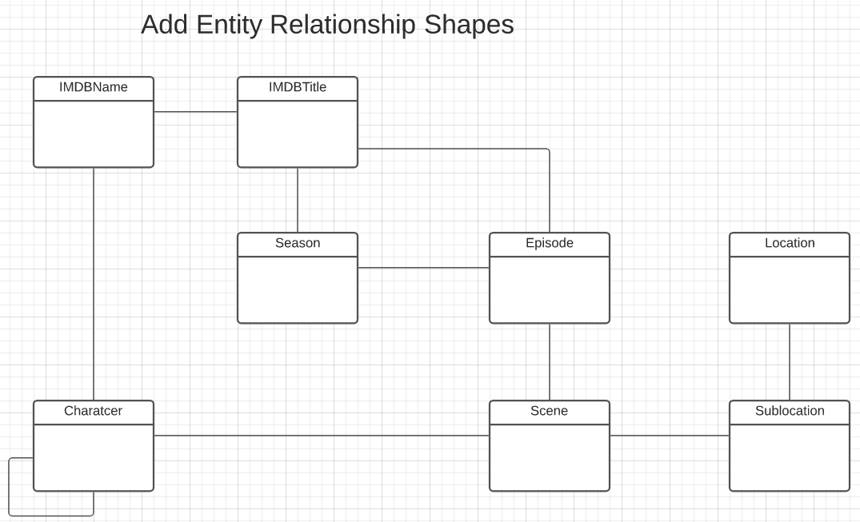
Game of Thrones – Conceptual Model
Add shapes in Lucidchart ...
With a little
Data exploration
Common sense
Judgment/experience
I came to this conceptual model.
Attributes unspecified
Relationship required/cardinality unspecified.
A little more exploration is needed.

Slide 54
Sample Projects
Walkthrough of Web Apps:
/Users/donaldferguson/Dropbox/000/000-A-Current-Examples/W4111-FastAPI-IMDB-Solution
/Users/donaldferguson/Dropbox/000/000-A-Current-Examples/current-dashboard
Data Engineering:
/Users/donaldferguson/Dropbox/000/000-Columbia/2024-Spring/W4111-Intro-to-Databases-Spring-2024/examples/process_got
And others.
Sample Notebook on GoT.

